Slide 1



EMT Simu-Save
"Building realistic scenarios to increase confidence and decision-making skills for Emergency Medical Technicians”
Phase 3: UI Design & Initial Implementation
CODEBLUE COLLECTIVE
Meghan Lawrence, Sophia Worsham

Slide 2
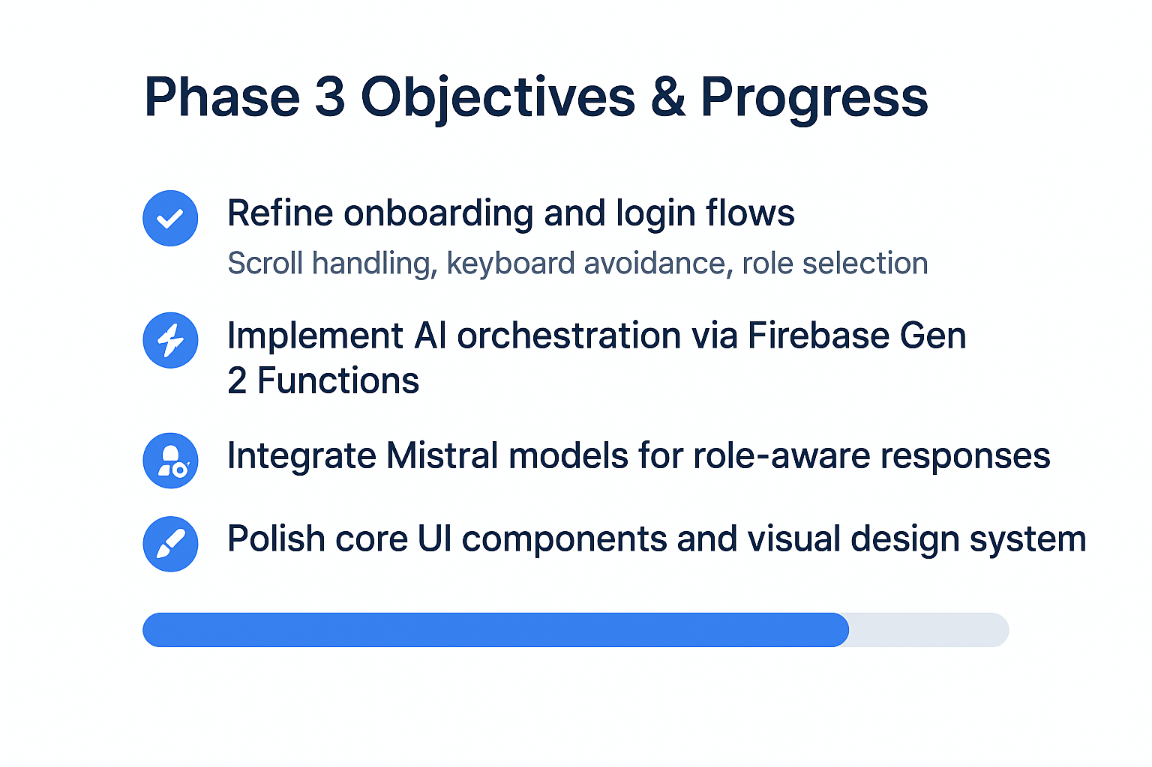

Slide 3
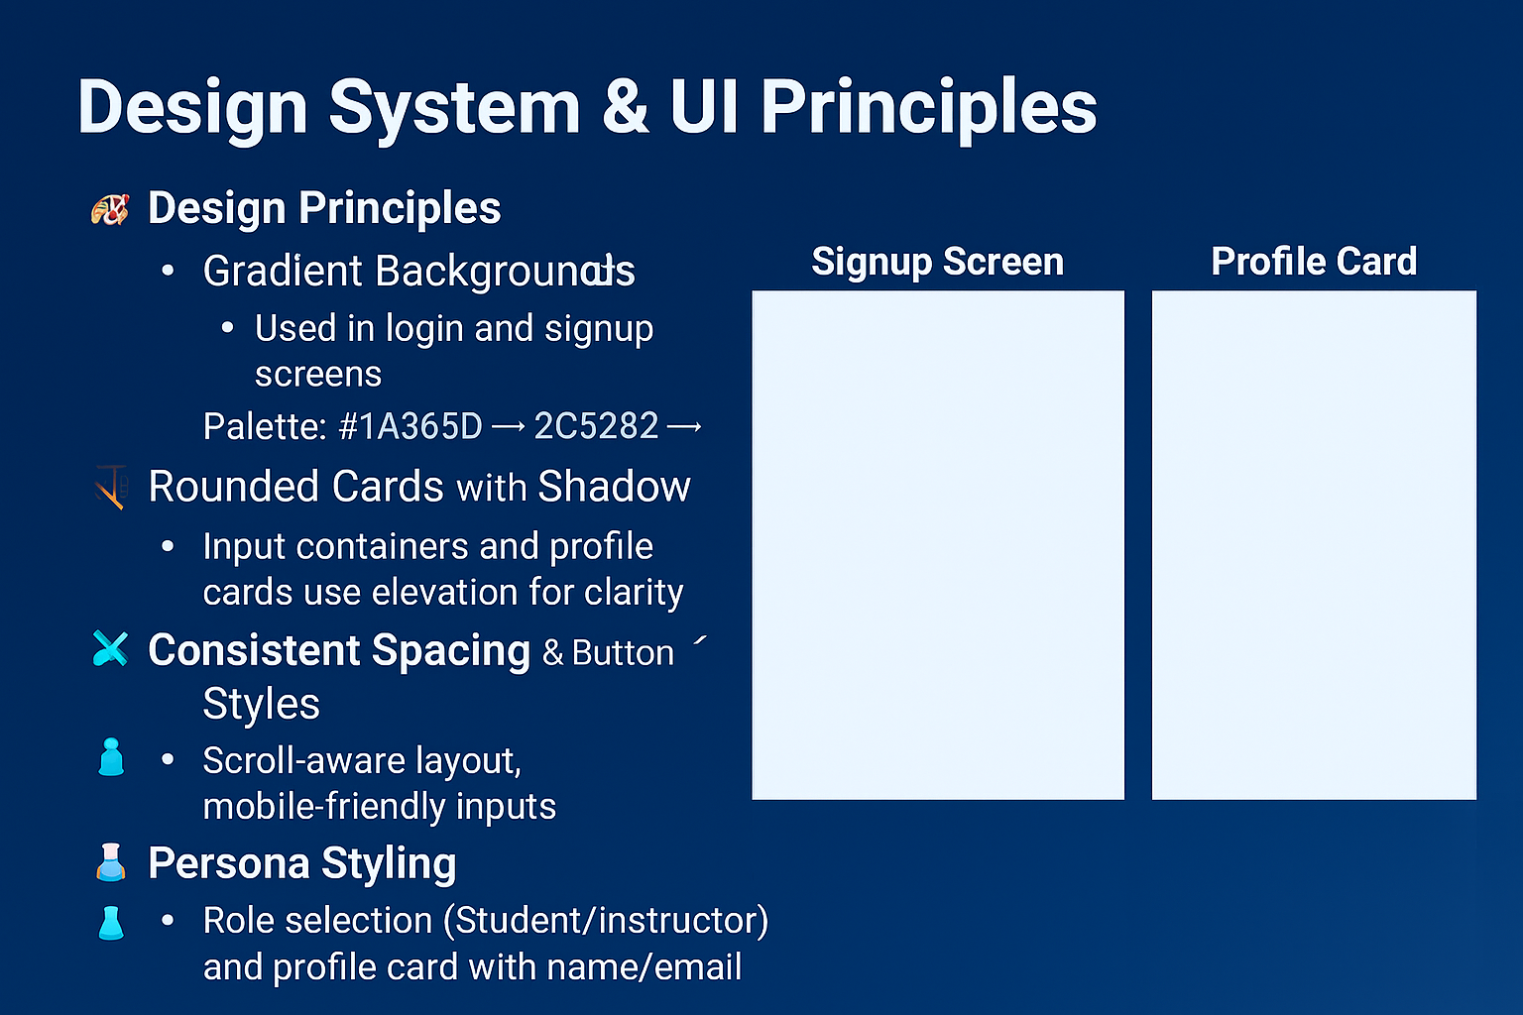
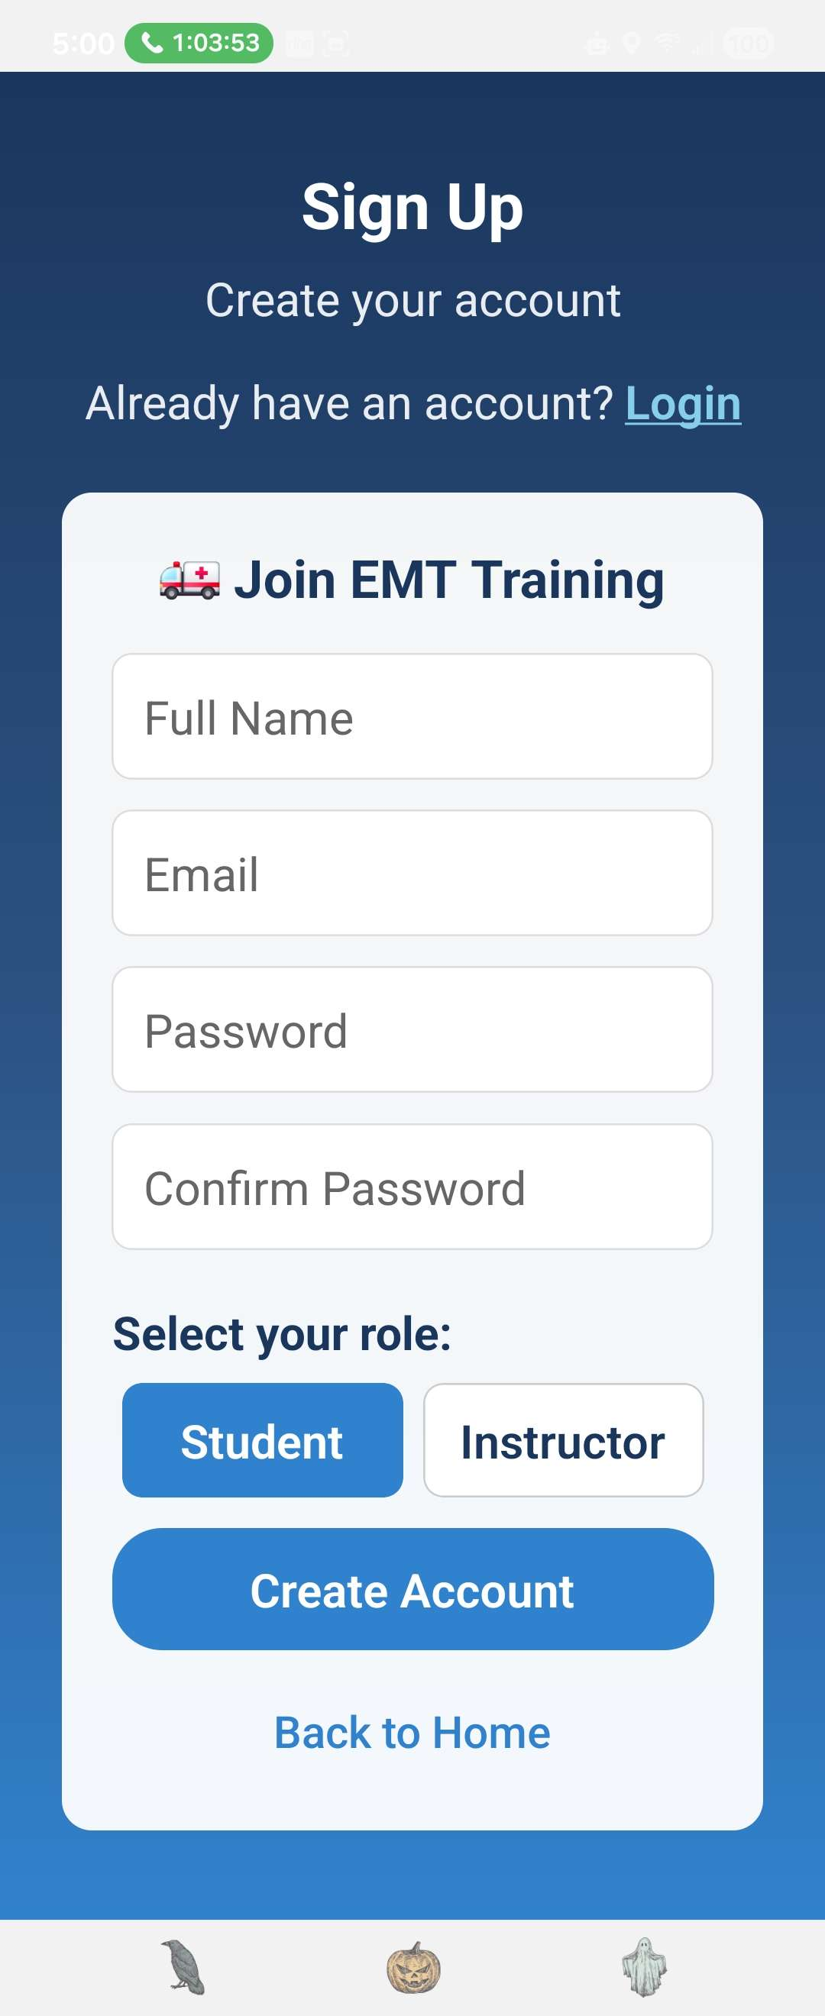
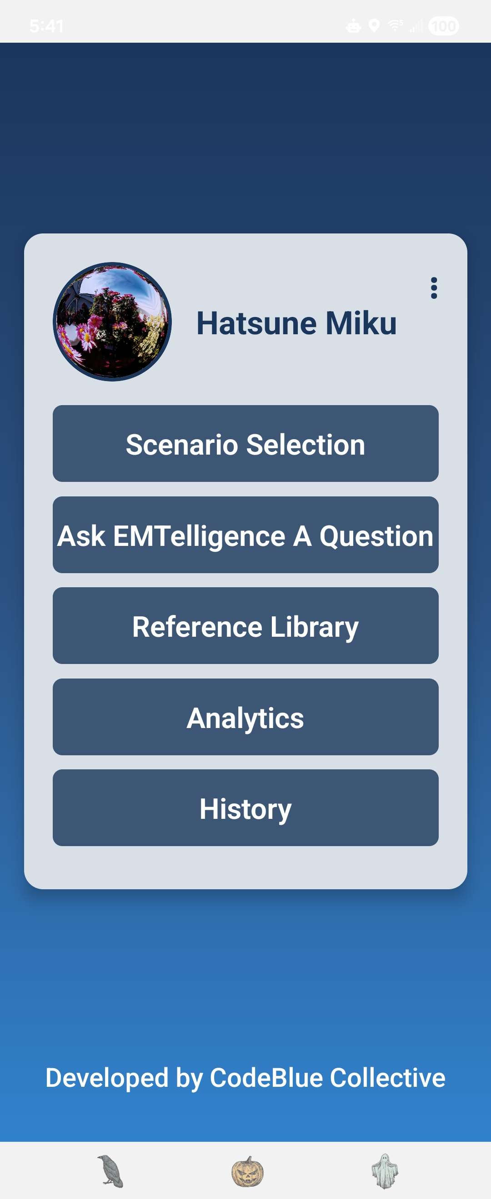

Slide 4
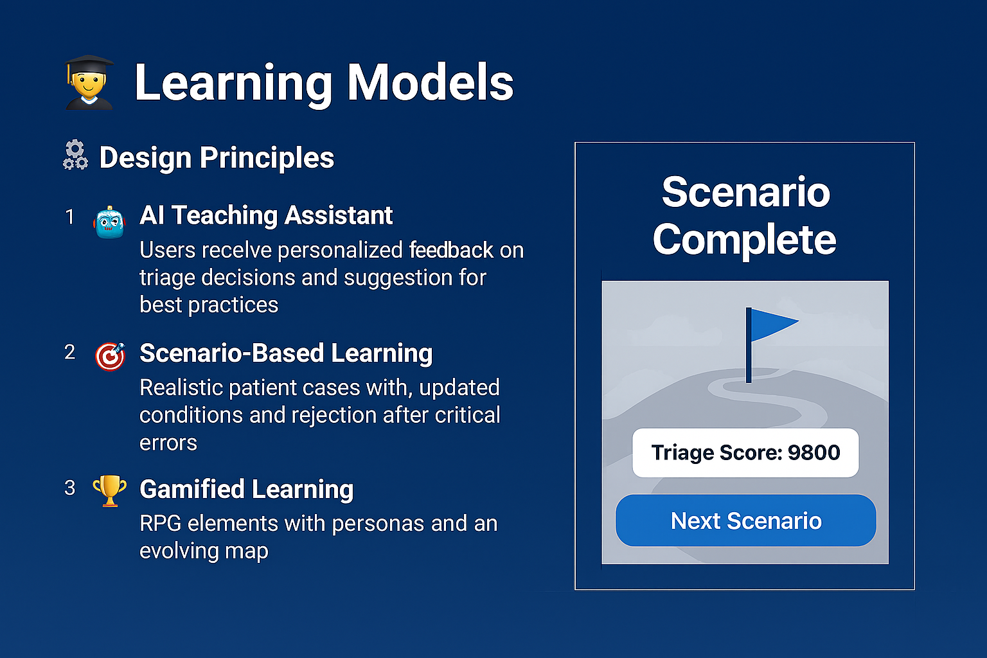
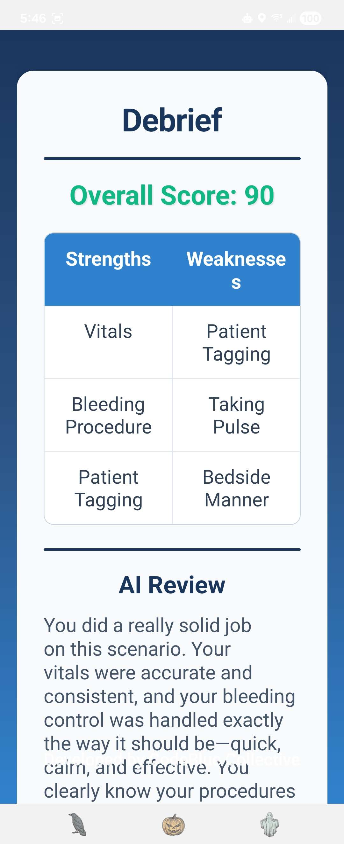

Slide 5
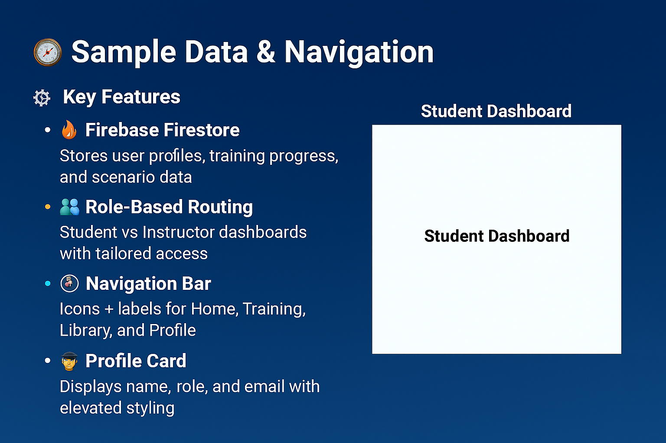

Slide 6
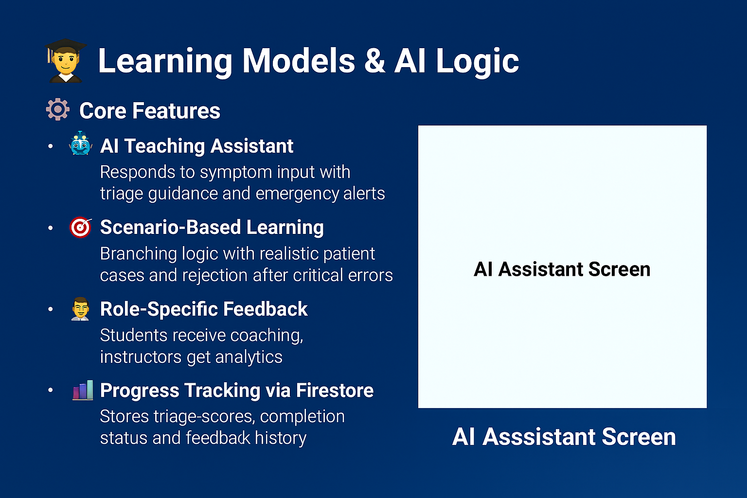
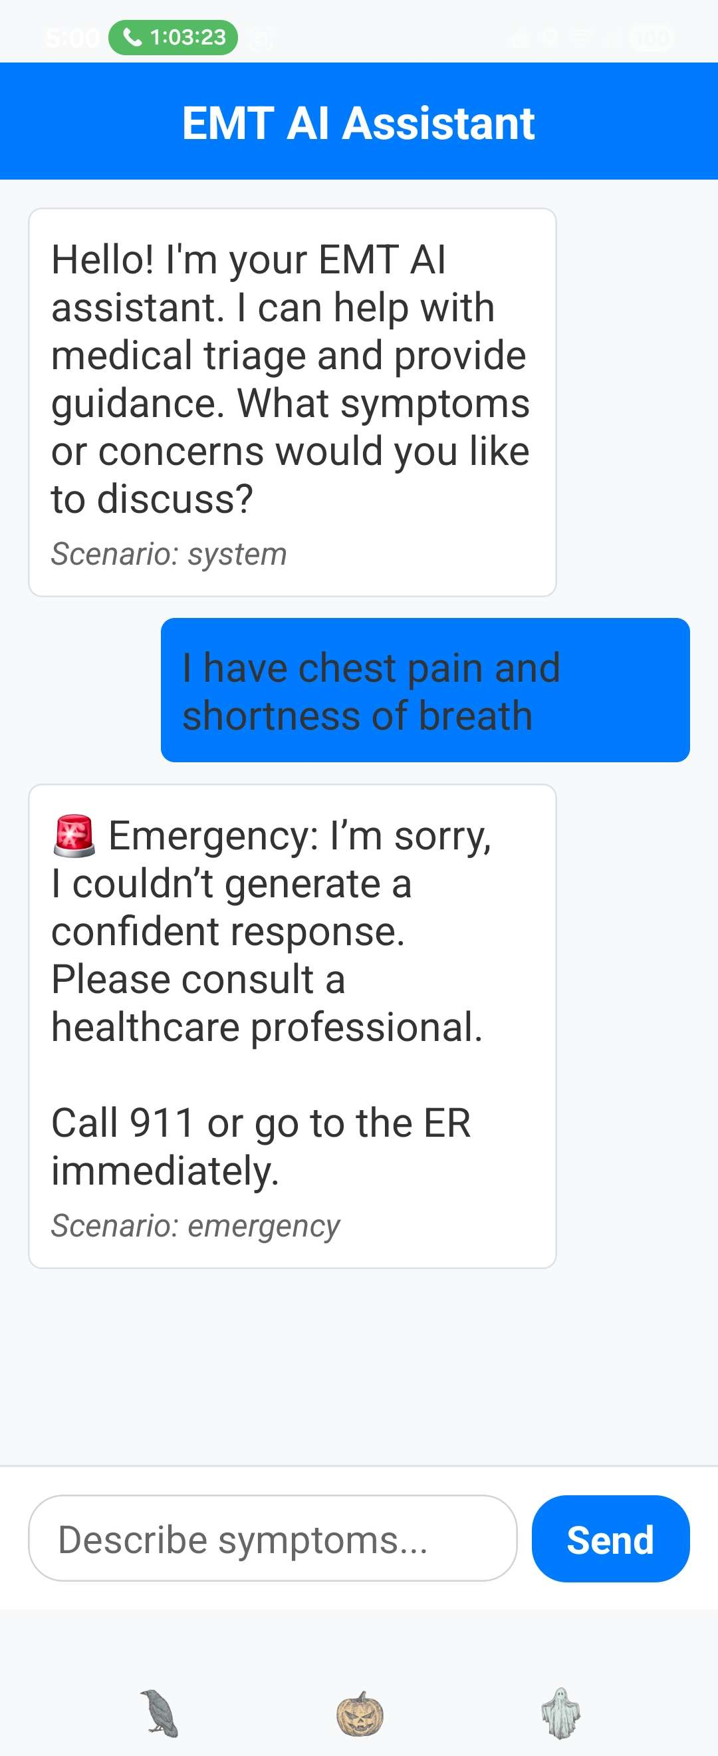

Slide 7
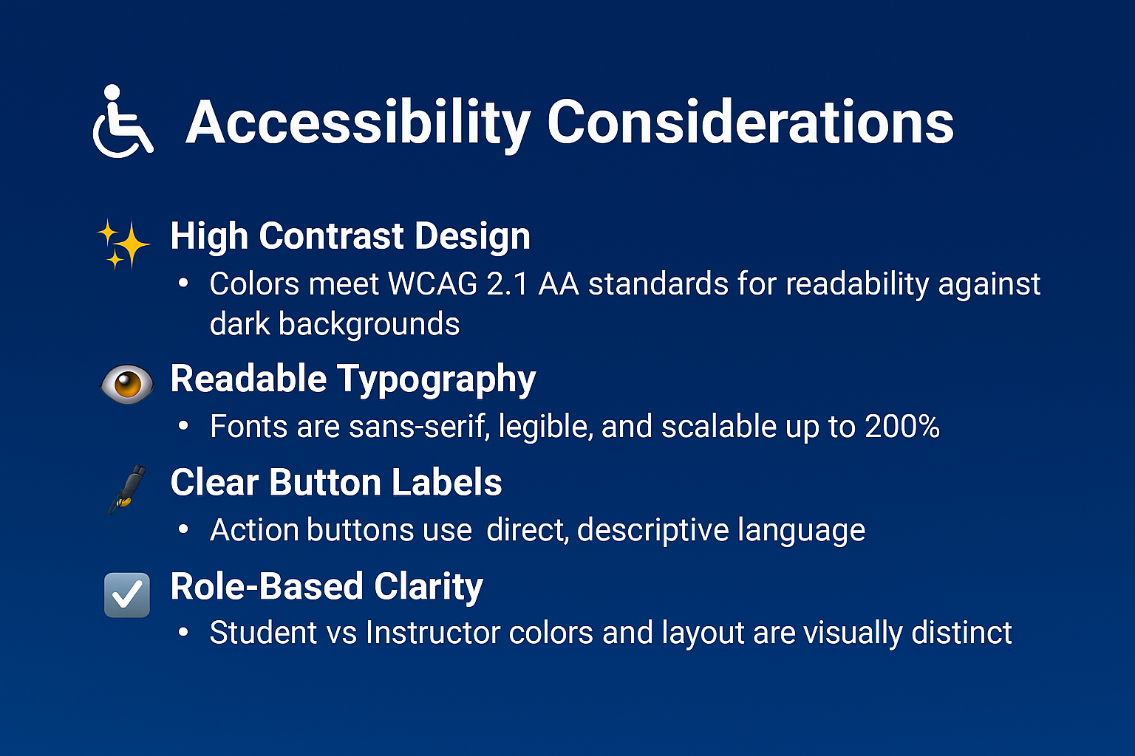

Slide 8
Visual Progress and Walkthrough

Slide 9
